Slide 1

SCHOOL OF COMPUTER SCIENCE, ENGINEERING AND APPLICATION
Master of Computer Applications (MCA)
(AIDS)
PROJECT:
PARKINSON’S DISEASE PREDICTION
By
Yashshree Sanjay Rasal : 20230804001
Shruti Sunil Hole : 20230804017

Slide 2
INTRODUCTION
A Parkinson's disease prediction system using machine learning is a tool designed to help diagnose or predict the likelihood of Parkinson's disease in individuals .
By analyzing data machine learning algorithms can learn to identify Parkinson's disease.
These algorithms are trained on datasets containing information from both Parkinson's patients and healthy individuals, enabling them to make predictions or classifications based on new data.
Prediction system hold promise for early detection and potentially improving patient outcomes and quality of life.

Slide 3
OBJECTIVE
Develop a predictive model for Parkinson’s Disease (PD) detection.
Integrate clinical assessments and spiral imaging data for comprehensive analysis.
Enhance early detection of PD by improving diagnostic accuracy.
Ensure a user-friendly interface accessible via web platforms.

Slide 4
FLOW CHART
START
INPUT CLINICAL VALUES
DATA PREPROCESSING
ML MODEL
TRAINING
TESTING
MODEL EVALUATION
RESULT
END

Slide 5


Slide 6


Slide 7


Slide 8
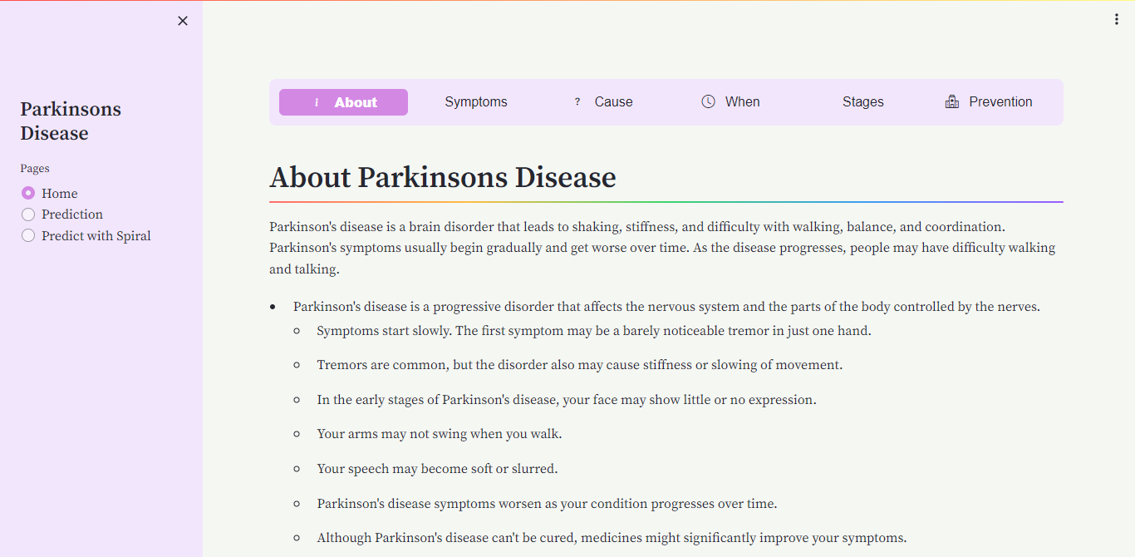

Slide 9
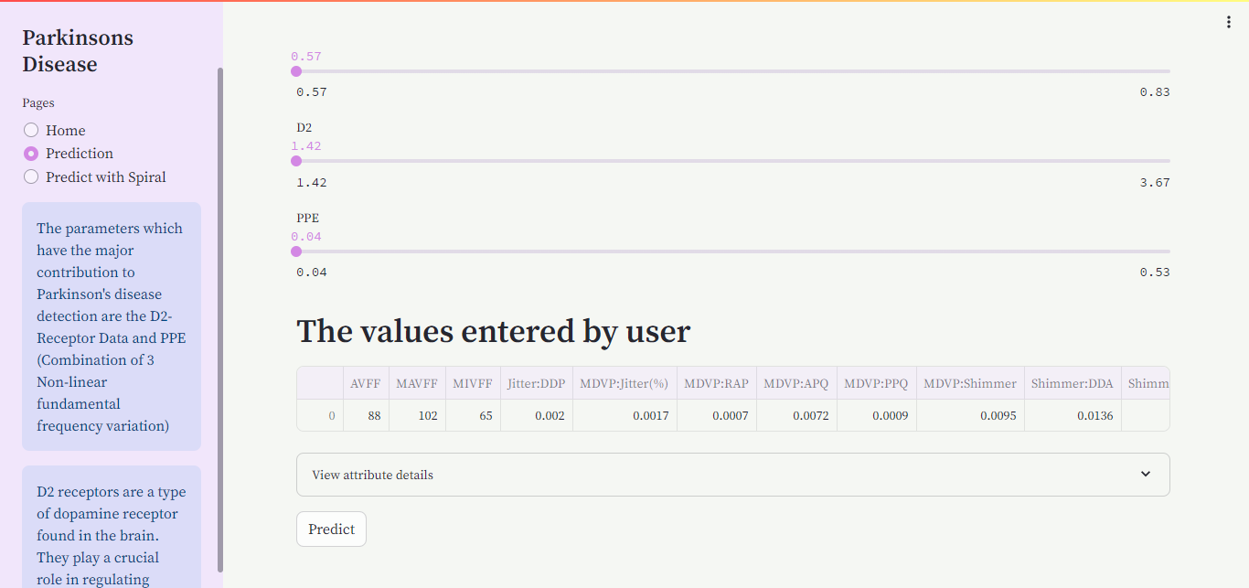

Slide 10
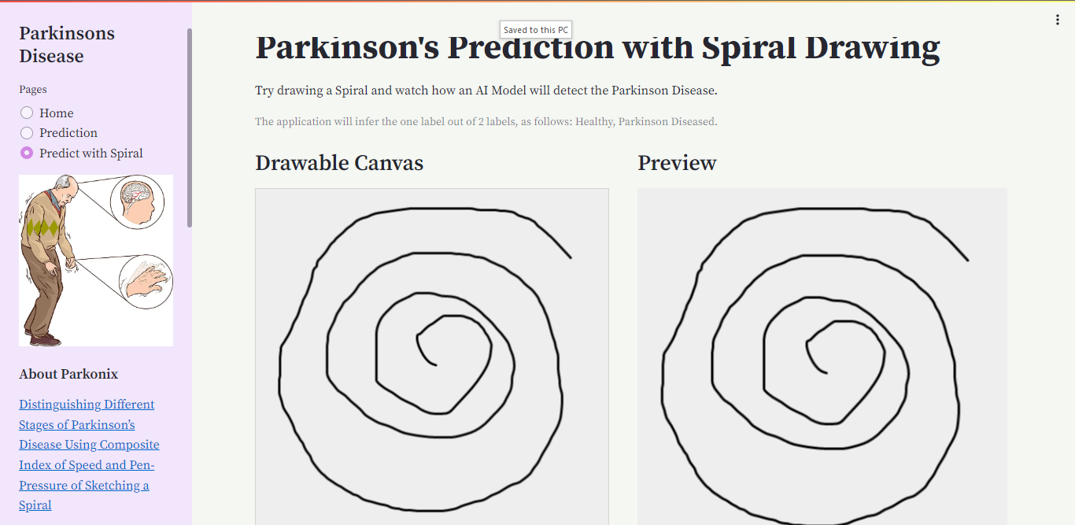

Slide 11
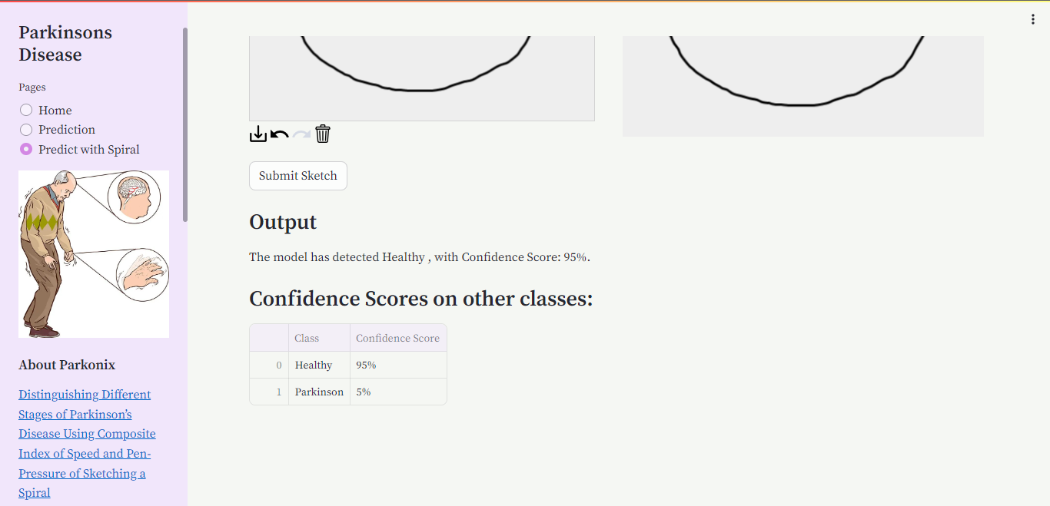

Slide 12


